Slide 1
Continuous and Transparent User Identity Verification for Secure Internet Services
By:
Chetan Kumar M 2451-12-737-001
Sai Kiran Reddy T 2451-12-737-009
MV Siva Abhishek 2451-12-737-033
Guided by:
Mr. Chandra Sekhar
Assistant Professor, DoIT

Slide 2
ABSTRACT:
Provide secure user authentication for web application.
- traditionally based on pairs of username and password
- biometric techniques offer emerging solution
A single authentication point and a single biometric data are not always sufficient to guarantee authenticity.
- trend towards multi-modal biometric and continuous authentication protocols
The proposed approach for user verification is Continuous Authentication system.
- adaptive session timeouts
- credentials acquired transparently

Slide 3
EXISTING SYSTEM vs PROPOSED SYSTEM:
EXISTING SYSTEM | PROPOSED SYSTEM
Username, password and single biometric verifications are used for authentication purposes. | 1.Instead of username password, we use multiple biometric verifications.
2.The identification of the user is constant during the whole sessions during the time of cyber attacks. | 2.The proposed system provides continuous authentication using fingerprint scan biometrics.
3.Re-authentication-It is the traditional process to identify user and cannot identify which process the user is accessing. | 3.Continuous authentication-It detects the physical presence of the user logged in the computer.

Slide 4
ADVANTAGES OF PROPOSED SYSTEM:
Our approach does not require that the reaction to a user verification mismatch is executed by the user device (e.g., the logout procedure), but it is transparently handled by the Continuous authentication service and the web services, which apply their own reaction procedures.
Provides a tradeoff between usability and security.

Slide 5
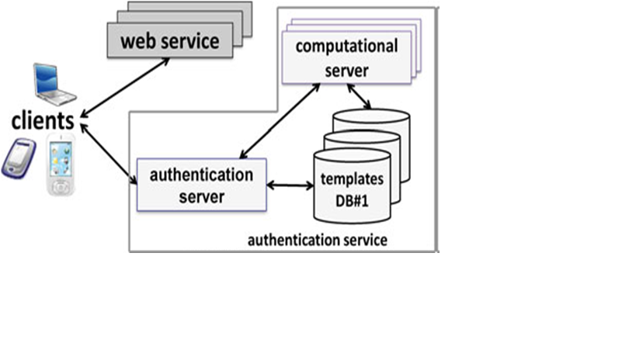
SYSTEM ARCHITECTURE:

Slide 6
REQUIREMENTS:
System : Pentium IV 2.4 GHz.
Hard Disk : 40 GB.
Ram : 512 Mb.
Operating system : Windows XP/7.
Coding Language : JAVA/J2EE
IDE : Netbeans 7.4
Database : MYSQL

Slide 7
MODULES:
System Model
Authentication Server
Continuous Authentication Certificate
Continuous Authentication Server

Slide 8
CLIENT
CONTINUOUS AUTHENTICATION
SERVER
WEBSERVICE
(Step 1)send all biometric traits
User identity verification
(Step 2)send CA certificate
(Step3)send request and CA certificate
(step 4)Access gained until timeout
Initiate phase

Slide 9
CLIENT
CASHMA
SERVER
WEBSERVICE
(Step 5)send biometric traits
User identity verification
(Step 6)send a fresh certificate
(Step7)send certificate to update the sessions time out
Maintenance phase

Slide 10
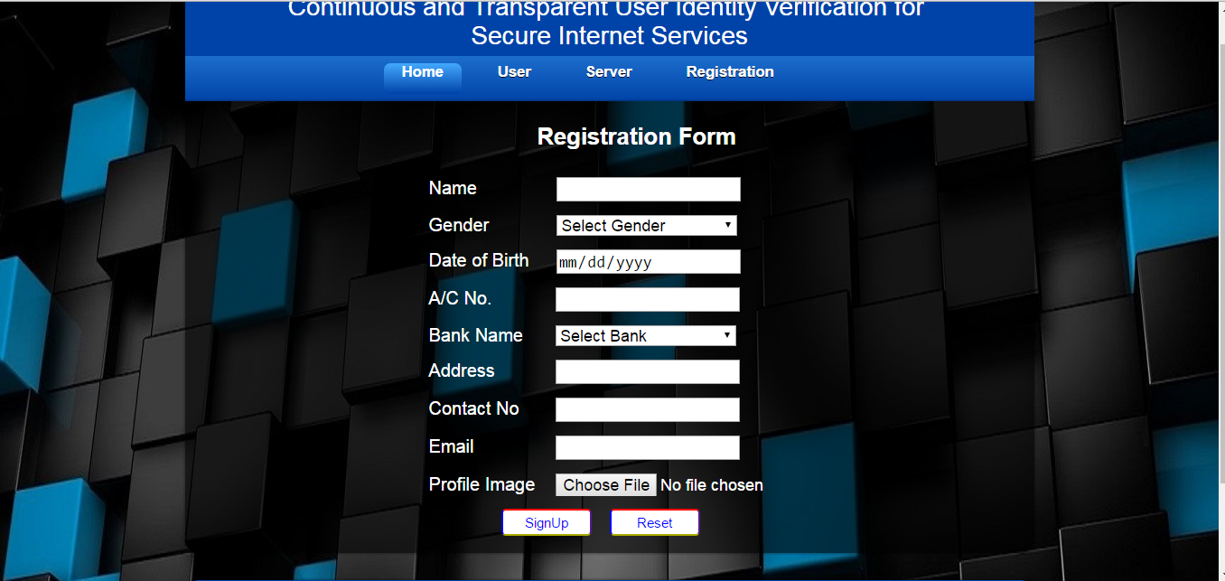
RESULTS AND DISCUSSIONS
User Registration Page

Slide 11
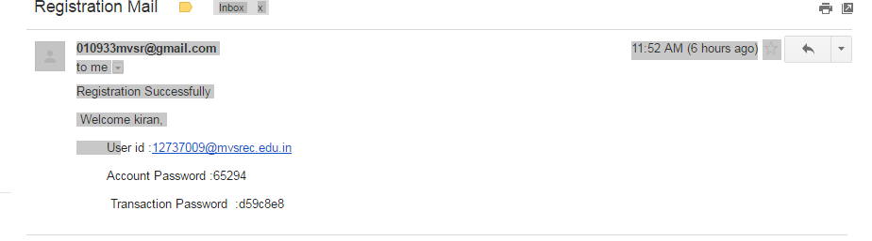
RESULTS AND DISCUSSIONS
User Account and Transaction passwords sent to mail

Slide 12
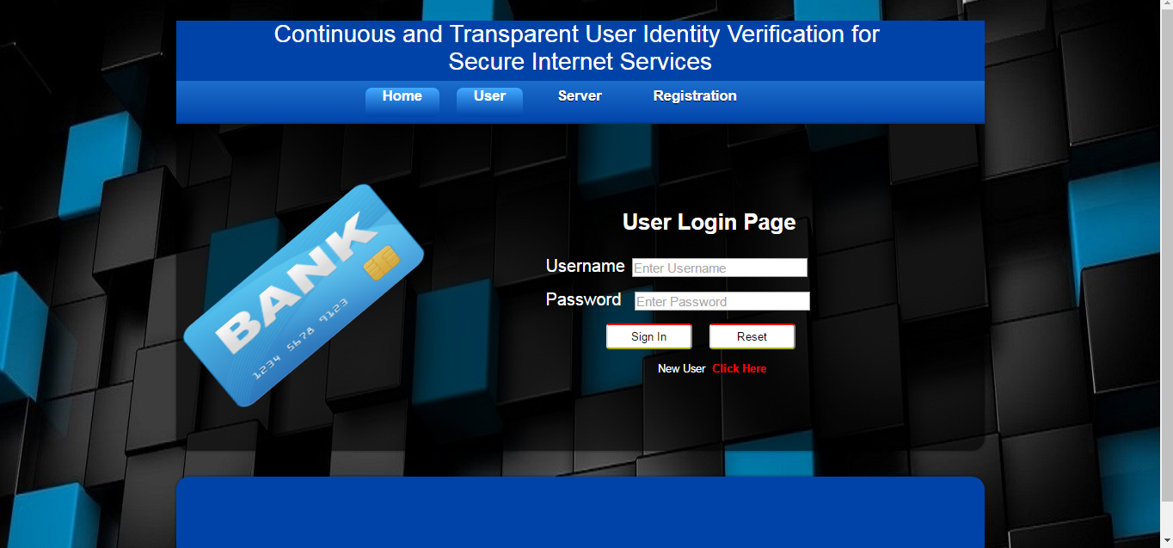
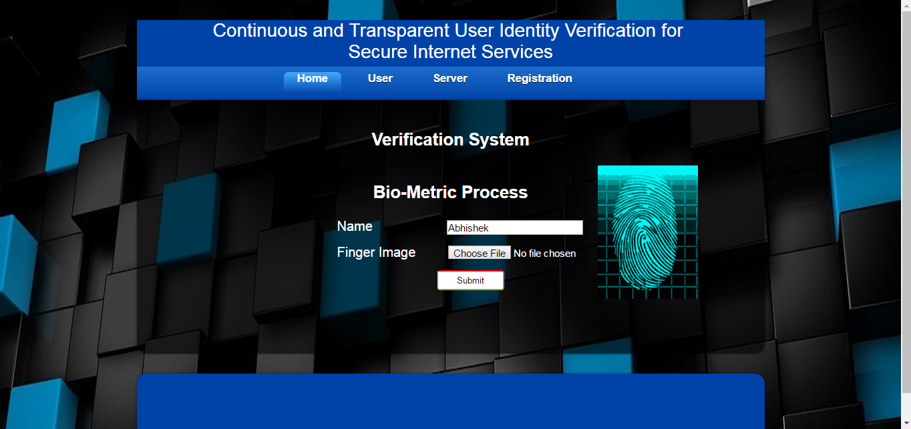
User Login and Verification Process

Slide 13
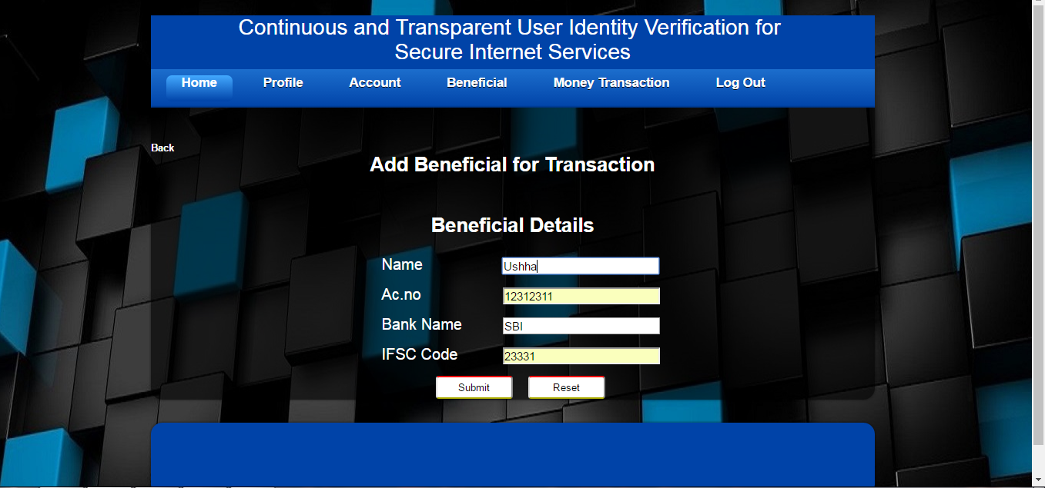
User adding Beneficiary account details

Slide 14
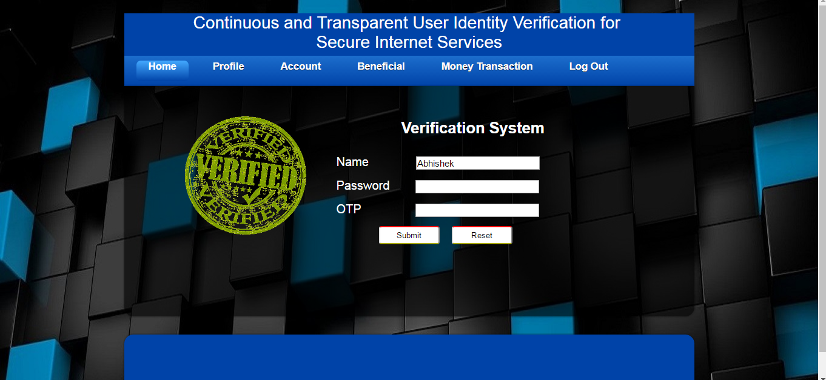
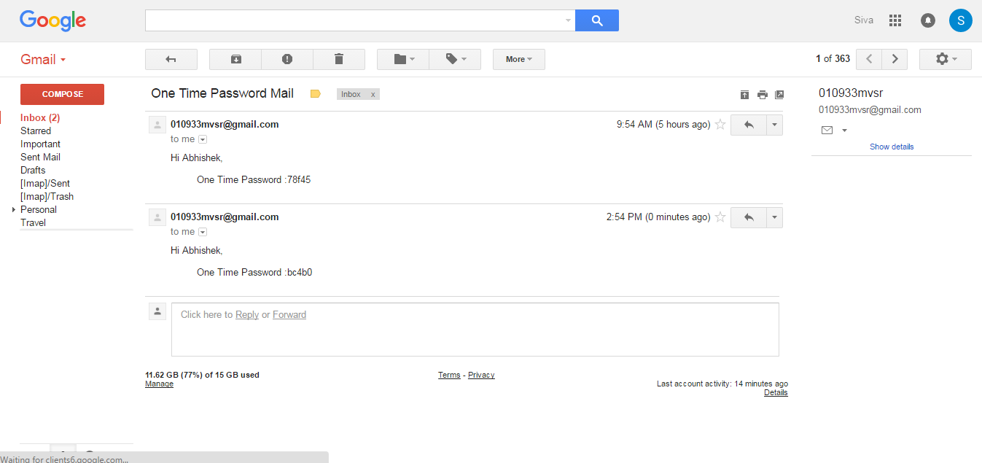
Login for money transaction and OTP generated

Slide 15
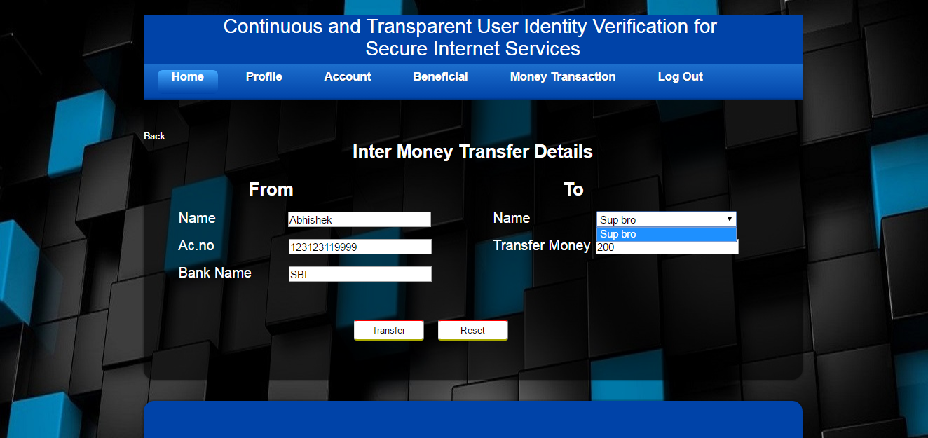
RESULTS AND DISCUSSIONS
Money Transfer details

Slide 16
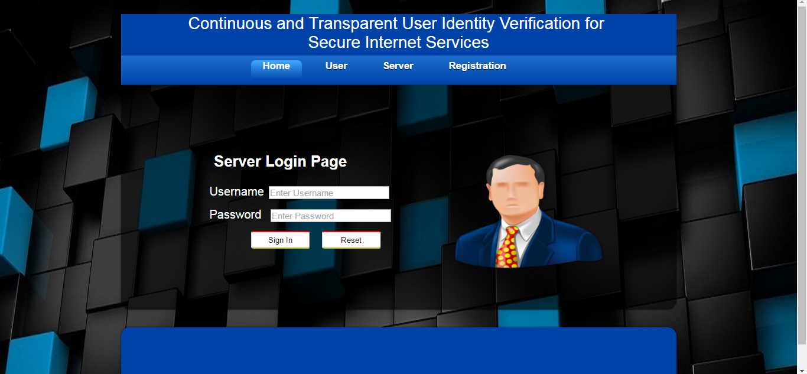
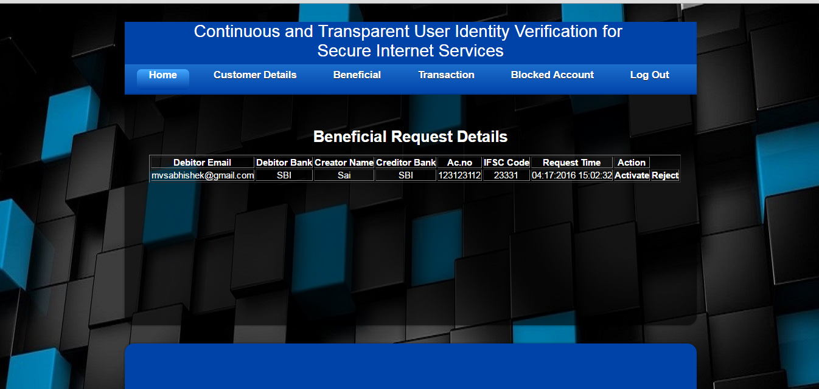
Server Operations

Slide 17
FUTURE SCOPE:
Improvisation of Real Time Bio-metric System account to the market standards.
Improved security services matching State of Art technologies.
Future implementation of Unified Payments interface(UPI) –
[RBI press release dated 12-04-2016 - Usage of QR code instead of adding beneficiary details and IFSC code for money transactions].

Slide 18
REFERENCE:
Andrea Ceccarelli, Leonardo Montecchi, Francesco Brancati, Paolo Lollini, Angelo Marguglio, and Andrea Bondavalli, Member, IEEE, “Continuous and Transparent User Identity Verification for Secure Internet Services”, IEEE TRANSACTIONS ON DEPENDABLE AND SECURE COMPUTING, VOL. 12, NO. 3, MAY/JUNE 2015.

Slide 19


